Slide 1
2-26-2025 remaining issues

Slide 2
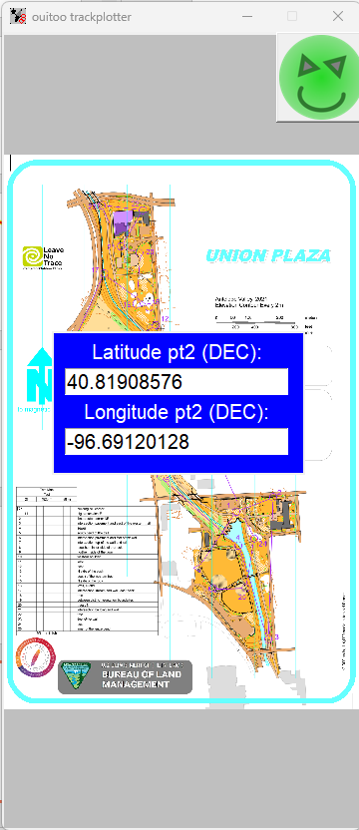
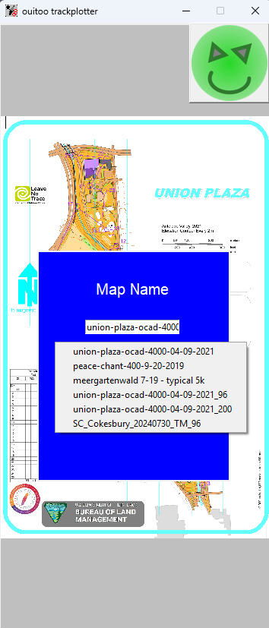
2-26-2025
5
Scale placement (Xpos, Ypos, width, height, font) parameters to the window diagonal
Make return button bg transparent

Slide 3
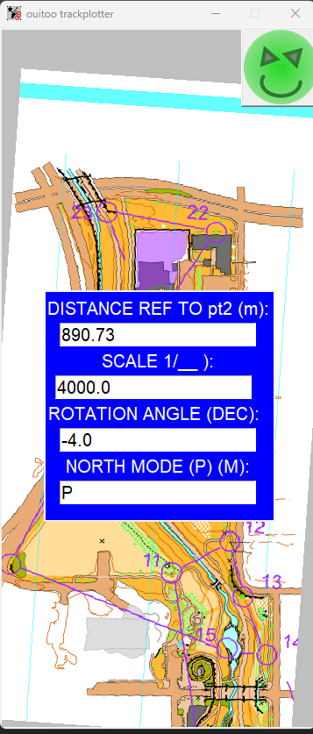
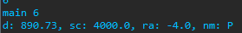
2-26-2025
7
Keep scale and display a text “Scale is: scale at DPI dpi” as a label with transparent bg
“Current Scale: scale” with a delay and disappearing ?

Slide 4
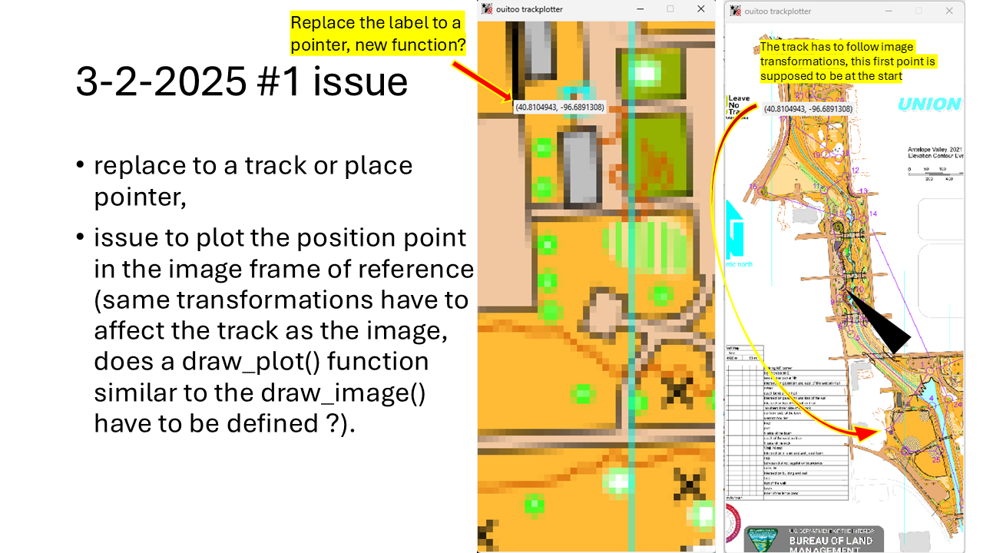
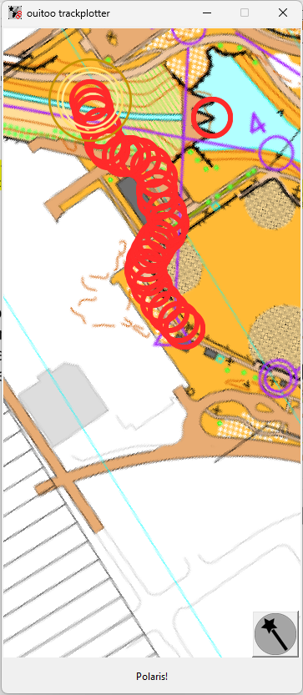
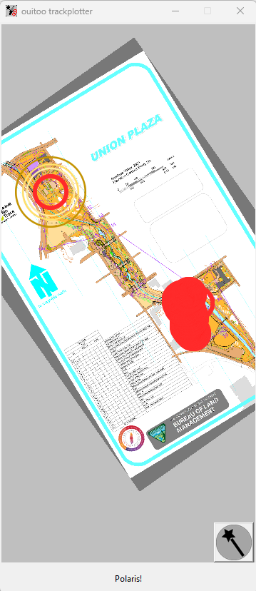
BEFORE
ACTUAL
A pointer is used to plot positions on the map
The track updates and follows image transformation
(2-26-2025 #1 issue fixed: no more pointer after exiting user inputs section)
3-2-2025 #1 issue fixed in user input Polaris Mode AND rotation angle set to 0.0

Slide 5
3-15-2025 issues

Slide 6
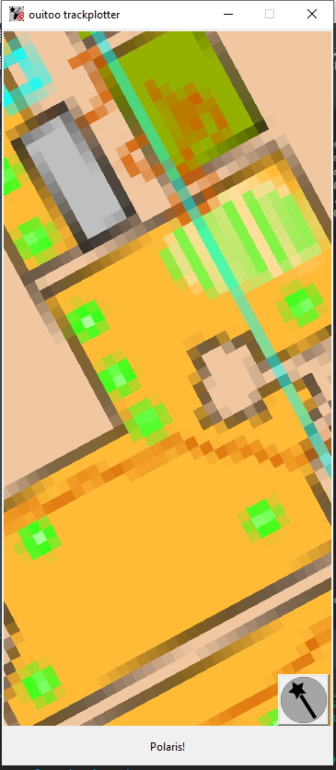
3-15-2025
1
Ctrl-Alt-Double click, binding to close the app
The binding on north icon should also kill the Thread started in GPS_to_screen() scope
Ctrl-Alt-Double click, binding to close the app
Scope of TrackPlot() ?

Slide 7
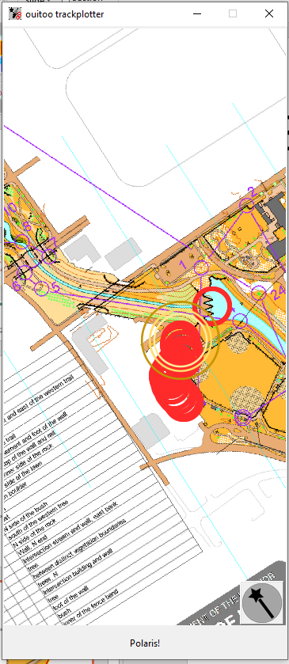
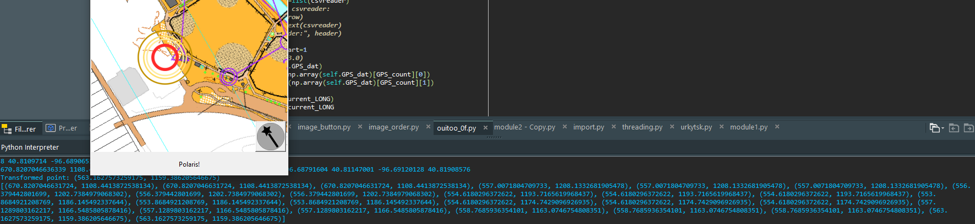
3-15-2025
Here, new user events get the plot to get updated to the current number of points to be plotted
2
The plot has to follow the number of transformed points (Note: during operation the positions are stored as a list and append at a certain rate/pace)
Ctrl-Alt-Double click, binding to close the app
Scope of TrackPlot() ?
# of transformed points to plot does not match # of plotted points

Slide 8
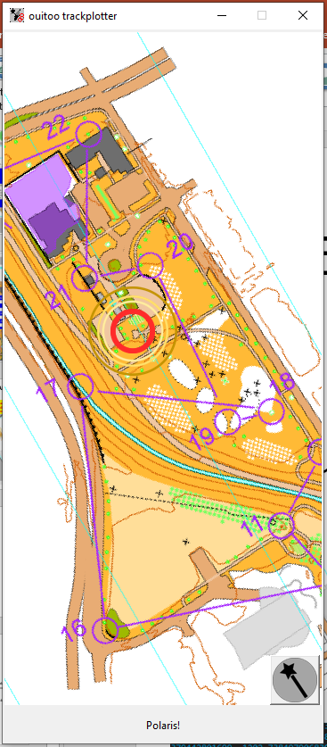
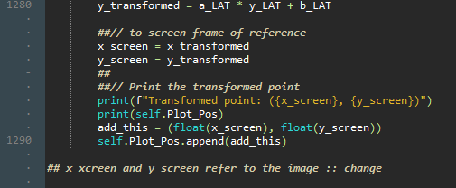
3-15-2025
Last element in Plot_Pos -in fact, user point #2- plots at its expected location
First element in Plot_Pos -in fact, user point #1 (Ref)- plots at its expected location
3
The positions stored as a list Plot_Pos[] are not plotted in the same way for first and last elements
Ctrl-Alt-Double click, binding to close the app
Scope of TrackPlot() ?
Other points should plot on the path

Slide 9
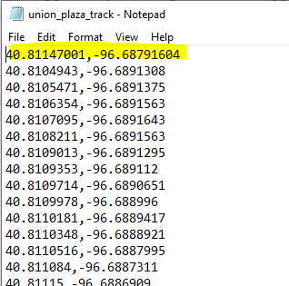
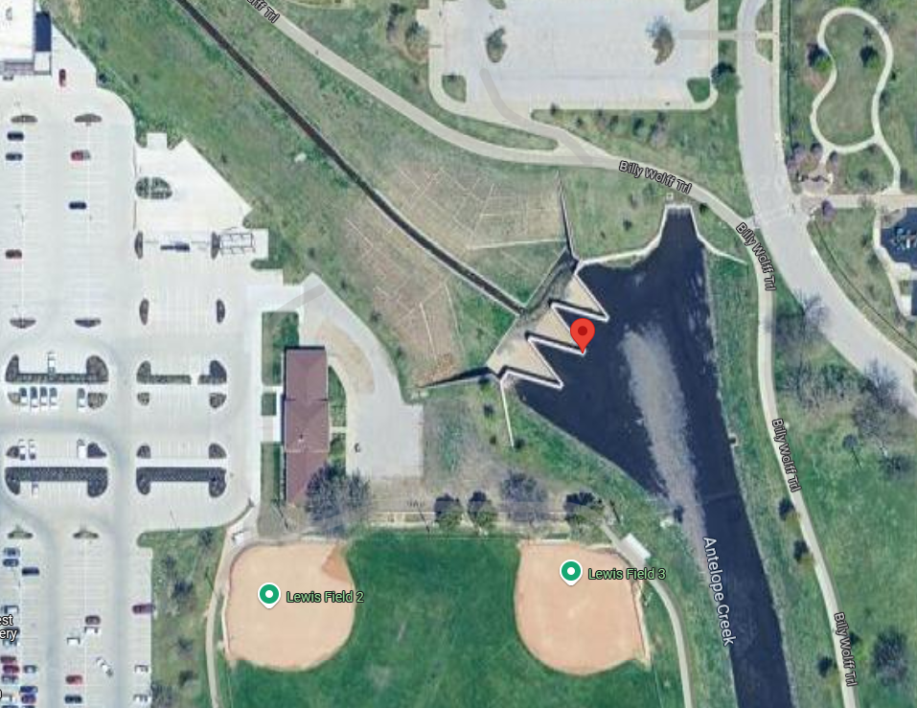
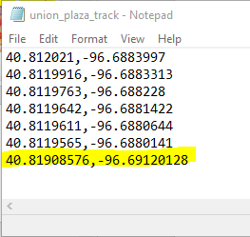
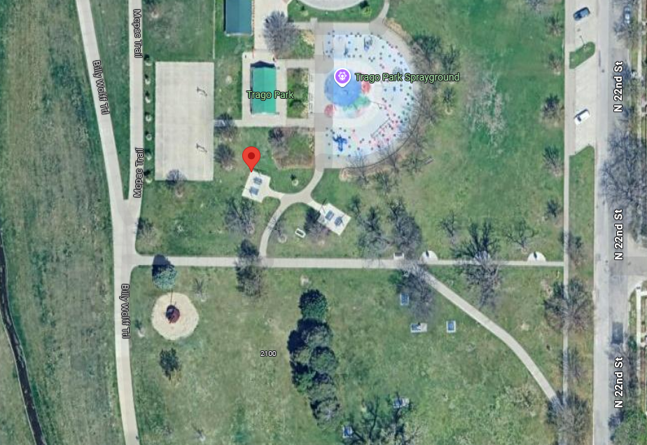
3-15-2025
Route Demo Track file, currently used and stored in Plot_Pos[] list (38 points total)
3 b
Only, first and last points of the route plot at their expected locations (both in Polaris w/o user rotation, or with user rotation)
Ctrl-Alt-Double click, binding to close the app
Scope of TrackPlot() ?

Slide 10
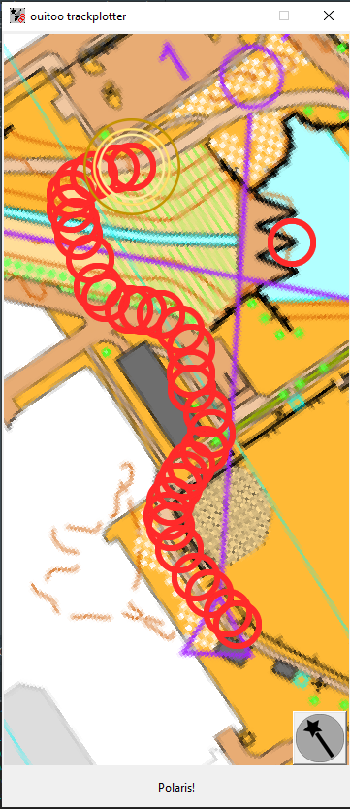
3-15-2025
Snip for the map set without a user rotation_angle
Points are plotted correctly on the path
Snip for the map set with a user rotation_angle
Points don’t plot on the path (expected to be)
3 c
With or W/o a user rotation angle the user points #1 (ref)and #2 plot at the correct locations
correct
correct
correct
Not correct
correct

Slide 11
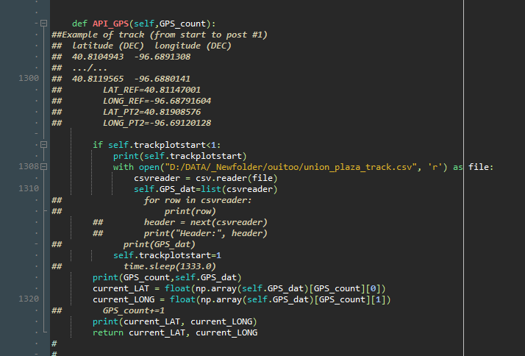
3-15-2025
4
API_GPS()
Change to a real 3rd party service or mobile capability instead of the demo list of positions to get the user position, think to the code

Slide 12
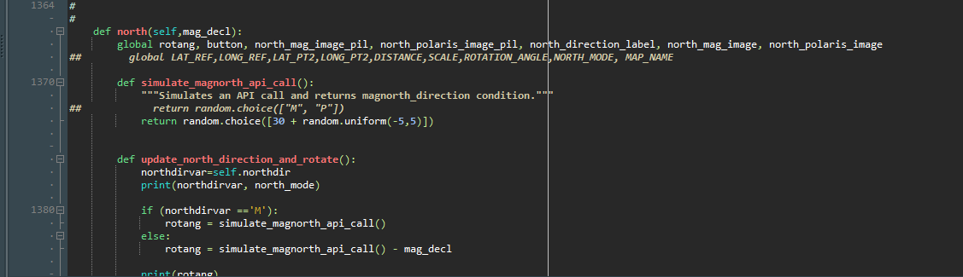
3-15-2025
5
north()
Integrate pygeomag package for the calculation of the magnetic deviation @at the location of the map

Slide 13
3-15-2025
6
north()
Change to a real 3rd party service or mobile capability instead of the simulate_magnorth_api_call(), think to the code

Slide 14
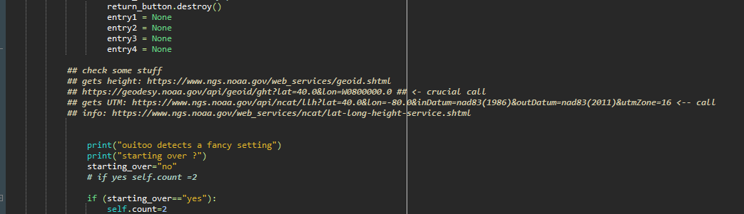
3-15-2025
7
Discussion for fancy errors
Using issue #5, and api call to another GIS 3rd party service, elaborate some predictions to detect fancy error in the user inputs

